Slide 1
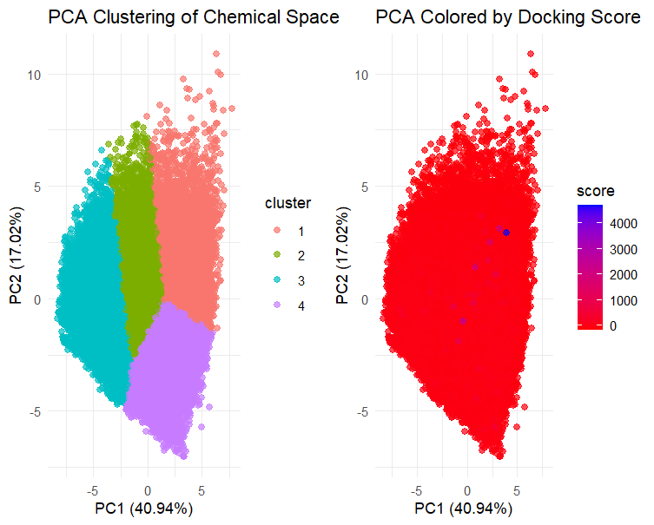
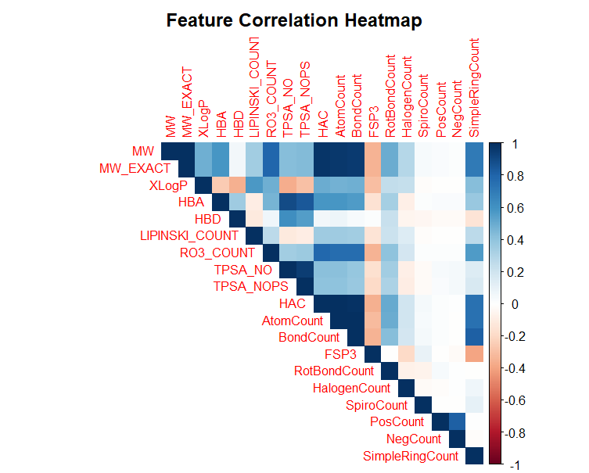
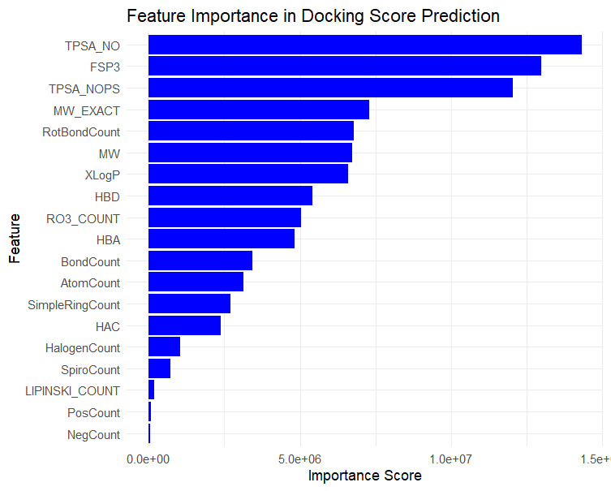
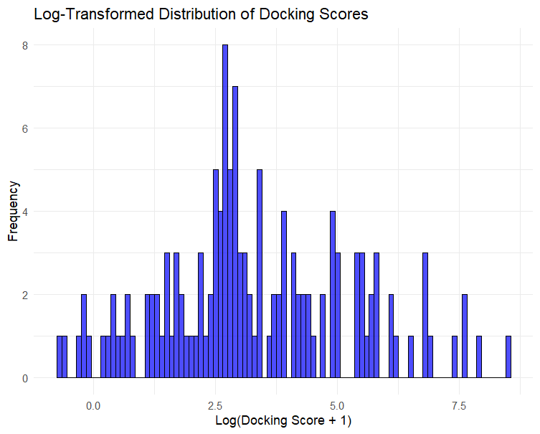
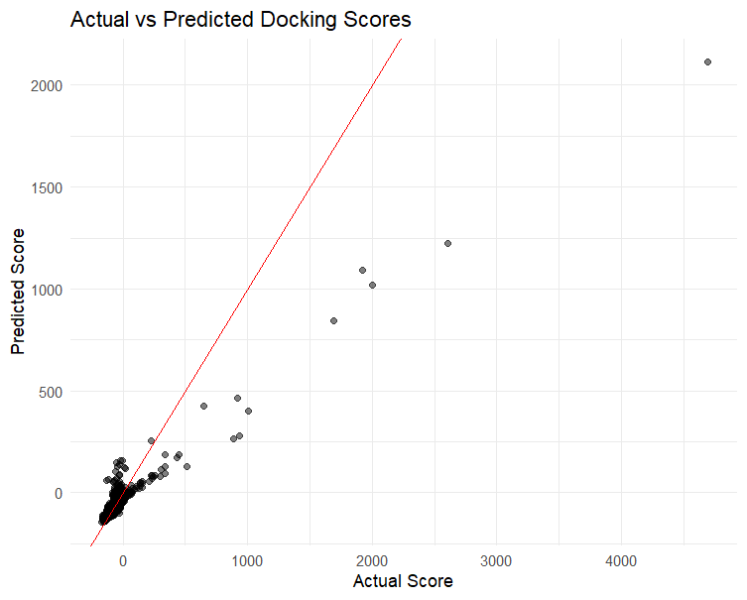
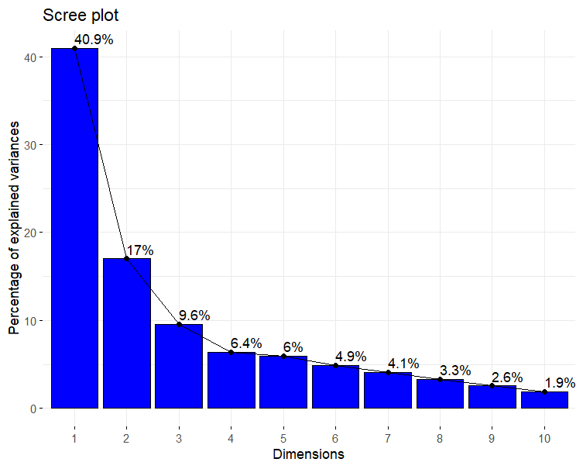
Computational Analysis of Chemical Space
A PCA, Clustering, & Docking Score Prediction Approach
Tyler Maire, Mahpara Abid, Peter Imonte, Gracious Isoah, Terry Ngala, & Mikayla Sheild
HackBio Bioinformatics Internship – Stage 3 Project – March 2025
Abstract
Understanding the chemical properties that influence molecular binding to protein targets is crucial for drug discovery. This study explores a dataset of over 10,000 compounds docked against adenosine deaminase (ADA), an enzyme linked to multiple diseases. We employ Principal Component Analysis (PCA) and K-means clustering to map the chemical space of these compounds and identify clusters with strong binding affinities. Additionally, we use machine learning regression
models to predict docking scores, highlighting key molecular descriptors that influence binding. Our findings reveal distinct chemical clusters and the molecular properties that contribute to strong ADA binding, paving the way for more efficient drug screening strategies.
Introduction
Methodology
Discussion & Results
Drug discovery is a complex and resource-intensive process that involves identifying and optimizing potential therapeutic compounds. Computational approaches, particularly molecular docking and machine learning have emerged as powerful tools for accelerating drug discovery by predicting the binding affinity of small molecules to target proteins. Molecular docking predicts how a ligand interacts with a biological target, providing insights into binding affinity, molecular interactions, and pharmacokinetic properties (Shoichet, 2004). However, the effectiveness of docking studies relies heavily on the molecular descriptors used to represent chemical compounds (Lipinski et al., 2001).
In recent years, dimensionality reduction techniques such as Principal Component Analysis (PCA) have been employed to analyze high-dimensional chemical descriptor data, facilitating the identification of key molecular properties that influence docking scores (Jolliffe & Cadima, 2016). PCA enables the visualization of chemical space, where compounds with similar properties cluster together, aiding in the classification and prioritization of potential drug candidates (Todeschini & Consonni, 2009). Furthermore, unsupervised clustering techniques like K-means clustering allow for the segmentation of compounds into groups based on their physicochemical properties. By clustering compounds into distinct chemical spaces, we can identify trends in molecular behavior and determine which structural features correlate with strong binding affinities (Jain & Nicholls, 2008).
Another crucial aspect of computational drug discovery is machine learning-based prediction models. In this study, we employ a Random Forest regression model to predict docking scores using molecular descriptors. Random Forest is a widely used ensemble learning method known for its robustness against overfitting and its ability to handle high-dimensional data (Breiman, 2001). By evaluating feature importance, we can determine which molecular properties have the greatest impact on docking outcomes, guiding the selection and optimization of promising compounds (Mitchell, 2014).
All analyses were performed in R using RStudio 2024.12.1+563 "Kousa Dogwood" Release on Windows 10 (64-bit). Libraries used included: dplyr & tidyr (data cleaning & manipulation); caret & randomForest (machine learning); factoextra & clustering (PCA & clustering); ggplot2, ggpubr, gridExtra, and corrplot (visualizations).
Preprocessing & Data Collection: data sourced from public Git Repository.
Variable names standardized using make.names()
Missing values, non-numeric values, & features with zero variance were excluded
Chemical descriptors converted to numeric values
Numerical descriptors scaled to zero mean and unit variance (ensures comparability)
Correlation Analysis: done to examine relationships between features (Figure 1)
Principal Component Analysis (PCA): explored the underlying structure of data & reduced complex dimensionality. Scree plot used to identify optimal principal components to retain. (Figure 2)
Clustering Analysis with K-means: explores how clustering of retained 2 PCs identified in PCA when K = 4 (Fig 3 – left) and colored by dock scores (Fig 3 – right)
Distribution Analysis of Docking Score: scores were log transformed using log(Docking Score +1) to normalize data & address initial right-skewness (Figure 4)
Random Forest Regression for Docking Score Prediction: done using 100 decision trees on preprocessed data to identify level of feature importance (Figure 5)
The number of decision trees used is to enhance stability and minimize variance
Model performance evaluation: compares the accuracy of docking scores predicted by Random Forest model against actual values (Figure 6)
Shows high performance for low-to-moderate docking scores and underestimates high-scoring outliers
Feature Correlation Analysis: found near perfect correlation (r~ 1.) between Mole. Weight (MW) & Exact Mole. Weight (MW_EXACT); strong intercorrelation between Topological polar surface area (TPSA_NO) & TPSA_NOPS; moderate correlation between rotatable bond count (RotBondCount) and docking score.
To reduce redundancy, only MW_EXACT can be considered.
TPSA_NO & TPSA_NOPS likely capture overlapping molecular properties; considering just TPSA_NO will cover the most information
The moderate correlation between RotBondCount & dock score suggests molecular flexibility possibly impacts ligand binding efficiency.
PCA & Chemical Space Exploration: optimally identified components to be retained with reduce complexity while capturing a majority of variance at 57.9%(PC1 = 40.94% & PC2 = 17.02%) and visualizing docking score in Figure 3
Red = low dock score & high affinity, Blue = high dock score & low affinity
Clustering Analysis of Chemical Space: suggests that a clustering into groups (as show in Fig 3-Right) is based on similar structure; this approach prioritized chemical scaffolds that demonstrate strong protein-ligand interactions that help in the drug discovery process
Docking Score Distribution Analysis: allowed for normalization of data, improving visualization and limiting impact of outliers. Key insights include:
Majority of candidates have moderate-to-strong binding affinities
High-scoring (low affinity) outliers suggest potential steric clashes, electrostatic interactions, or poor ligand complementarity in simulations
Feature Importance Random Forest Model: Trained on docking scores to identify most important molecular descriptors that influence the scores and identified TPSA_NO, FSP3, & MW_EXACT as the most important features
TPSA_NO: measures H-bonding capacity; indicates role of polar interactions
FSP3: represents the fraction of sp3-hybridized carbons; links molecular flexibility in enhancing binding
MW_EXACT: highlights the influences of steric effects and molecular stability
Model Performance Evaluation: Found the Random Forest model accurately predicts low-to-moderate docking scores yet underestimates high docking scores. Overall agreement between predicted and actual scores supports the use of machine learning
Future improvements could utilize more complex machine learning techniques
Figure 3: Left shows PCA visualization, displaying the K-means clustering of chemical space (K=4). Right shows docking score where red represents low docking score (high affinity) and blue represents high docking score (low affinity).
Figure 5: Feature importance ranking derived from Random Forest model. TPSA_NO, FSP3, and MW_EXACT identified as the most influential descriptors in docking score prediction.
Figure 1: Heat map showing correlation between features.
Conclusion
Objectives
This study demonstrated how dimensionality reduction, clustering, and machine learning techniques can be used to analyze chemical space and predict docking scores. We were able to identify key molecular descriptors that influence docking affinity through the combination of Principal Component Analysis, K-means clustering, feature correlation analysis, and Random Forest regression.
Potential implications drawn from this study include:
Computational identification of molecular descriptors & filtering of drug candidates can allow for virtual screening optimization, reducing the number of false positives.
Molecular scaffolding impacts how strong protein-ligand interactions can be, as alluded to by the clustering analysis.
Machine-learning can aid in careful feature selection in drug discovery, whose results can aid in developing improved descriptors that capture more complex interaction patterns.
Limitations in this study exist in the relatively simple machine learning technique used and analyses completed based on one aspect of drug discovery (that being docking score). Further improvements on this study could include:
Incorporating additional molecular features
Implementing Deep Learning Approaches (such as Graph Neural Networks (GNNs))
Supporting predicted scores with experimental validation
1. Analyze the correlation between chemical descriptors and docking scores using a feature correlation heatmap.
2.Apply PCA to visualize the distribution of compounds in chemical space and identify major variance-contributing features.
3. Perform K-means clustering to classify compounds based on their physicochemical properties.
4. Train a Random Forest model to predict docking scores and identify the most significant molecular descriptors.
5. Evaluate model performance through actual vs predicted docking score analysis.
Figure 4: Log-transformed distribution of docking-scores. Transformed data allows normalization and reduces influence of extreme values.
Figure 2: Scree plot measuring % variance between dimensions. Majority of variance occurs in dimensions 1 & 2 (cumulative 57.9%).
Figure 6: Scatter plot of actual vs. predicted docking scores. The model shows strong performance for lower docking scores but struggles with high-scoring outliers.
References
Bender, A. & Cortes-Ciriano, I. (2021). Artificial Intelligence in drug discovery: What is real and what is hype? Genome Biology, 22(1), 1-14. https://doi.org/10.1186/s13059-021-02324-2
Breiman, L. (2001). Random forests. Machine Learning, 45(1), 5-32. https://doi.org/10.1023/A:1010933404324
Gaudelet, T., Day, B., Jansen, J., Liu, G., & Zang, X. (2020). Utilizing deep learning and generative models for drug design. Nature Reviews Drug Discovery, 19(8), 527-542. https://doi.org/10.1038/s41573-020-0073-z
Hartigan, J.A. & Wong, M.A. (1979). Algorithm AS 136: A K-means clustering algorithm. Journal of the Royal Statistical Society: Series C (Applied Statistics), 28(1), 100-108. https://doi.org/10.2307/2346830
Jain, A.K. (2010). Data clustering: 50 years beyond K-means. Pattern Recognition Letters, 31(8), 651-666. https://doi.org/10.1016/j.patrec.2009.09.011
Jolliffe, I.T. (2002). Principal component analysis (2nd ed.). Springer. https://doi.org/10.1007/b98835
Jumper, J., Evans, R., Pritzel, A., Green, T., Figurnov, M., Ronneberger, O., … & Hassabis, D. (2021). Highly accurate prediction with AlphaFold. Nature, 596(7873), 583-589. https://doi.org/10.1038/s41586-021-03819-2
Kuhn, M. & Johnson, K. (2013). Applied predictive modeling. Springer. https://doi.org/10.1007/978-1-4614-6849-3
Lever, J., Krzywinski, M., & Altman, N. (2017). Principal component analysis. Nature Methods, 14(7), 642-642. https://doi.org/10.1038/nmeth.4346
Lipinski, C.A. (2004). Lead- and drug-like compounds: The rule-of-five revolution. Drug Discovery Today: Technologies, 1(4), 337-341. https://doi.org/10.1016/j.ddtec.2004.11.007
Morris, G.M., Huey, R., Lindstrom, W., Sanner, M.F., Belew, R.K., Goodsell, D.S., & Olson, A.G. (2009). AutoDock4 and AutoDockTools4: Automated docking with selective receptor flexibility. Journal of Computation Chemistry, 30(16), 2785-2791. https://doi.org/10.1002/jcc.21256
Todeschini, R. & Consonni, V. (2009). Molecular descriptors for chemoinformatics. Wiley-VCH. https://doi.org/10.1002/9783527628766

